Slide 1
ASPIRE TRAINING
RANDOMIZATION & INITIAL DISPENSING
Cindy Jacobson, PharmD (MTN)
Jen Berthiaume/Missy Cianciola (SCHARP)

Slide 2
Overview
Randomization
Prescriptions
Initial Study Product Dispensation
Clinic Product Accountability

Slide 3
Randomization
Randomization = assignment of a MTN-020 prescription
Once randomized, the ppt is enrolled
SCHARP will provide each site with a binder containing prescriptions in sequential Randomization Number order
This binder remains in the clinic at all times

Slide 4
Randomization/Prescription Assignment
Page 317
Prescriptions must be assigned in sequential randomization number order
Document sequential assignment on the MTN-020 Randomization/Prescription Tracking Record for Clinic
  Provided by SCHARP with the prescription binder
Complete one row each time a prescription is assigned
  PTID, date assigned, time assigned, clinic staff initials
Notes:
4

Slide 6
Prescription - continued
Page 319
Each prescription will have a unique randomization number pre-printed on it
Only one prescription per ppt
Once a prescription is assigned, it cannot be re-assigned
Randomization Number tells Pharmacy which ring to dispense
No one knows if the ring dispensed is dapivirine or placebo
  Site staff, not FHI.360, not SCHARP, not Jared or Thes, not Safety Physicians

Slide 7
Prescription Completion
Prescriptions are two-part NCR forms
  Top copy – white
  Bottom copy - yellow
In the top section of the prescription, record the PTID and mark whether the participant provided IC
Notes:
No-carbon required

Slide 8
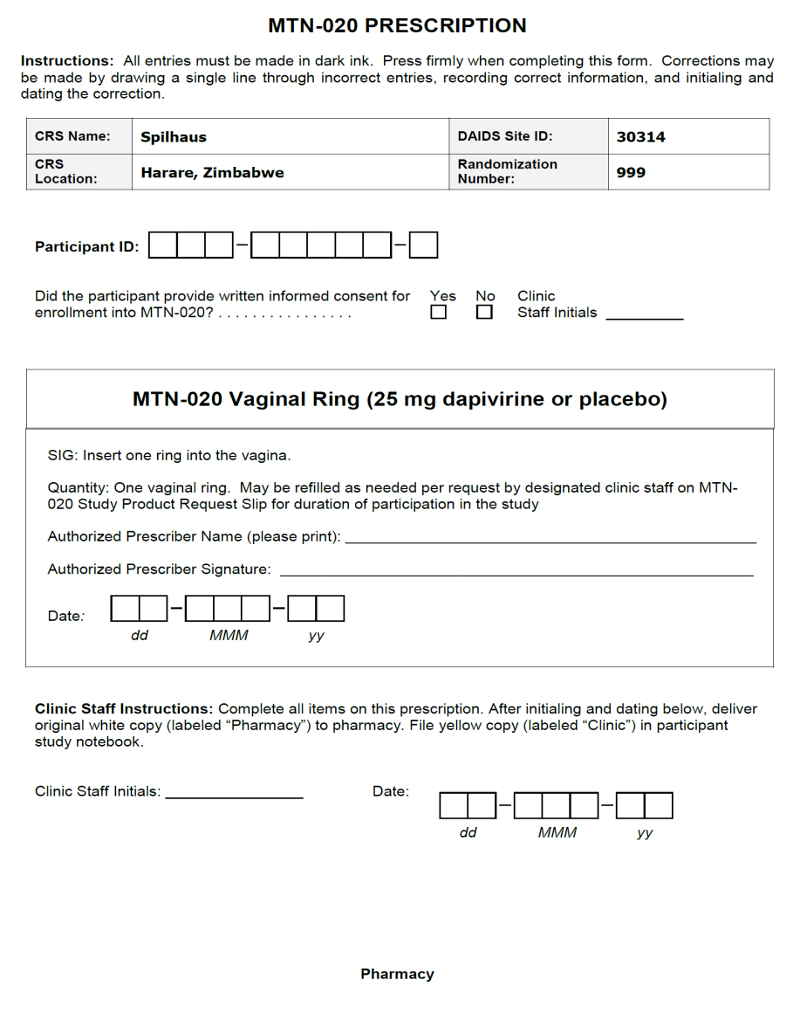
MTN-020 PRESCRIPTION
Notes:
As you can see here, like with VOICE the top white copy is PHARMACY and the bottom yellow is retained in the participant binder.

Slide 9
Prescription Completion
The person who marks the informed consent check box is responsible for confirming the presence of a properly signed/marked and dated informed consent form for enrollment prior to recording his/her initials beside these boxes.

Slide 10
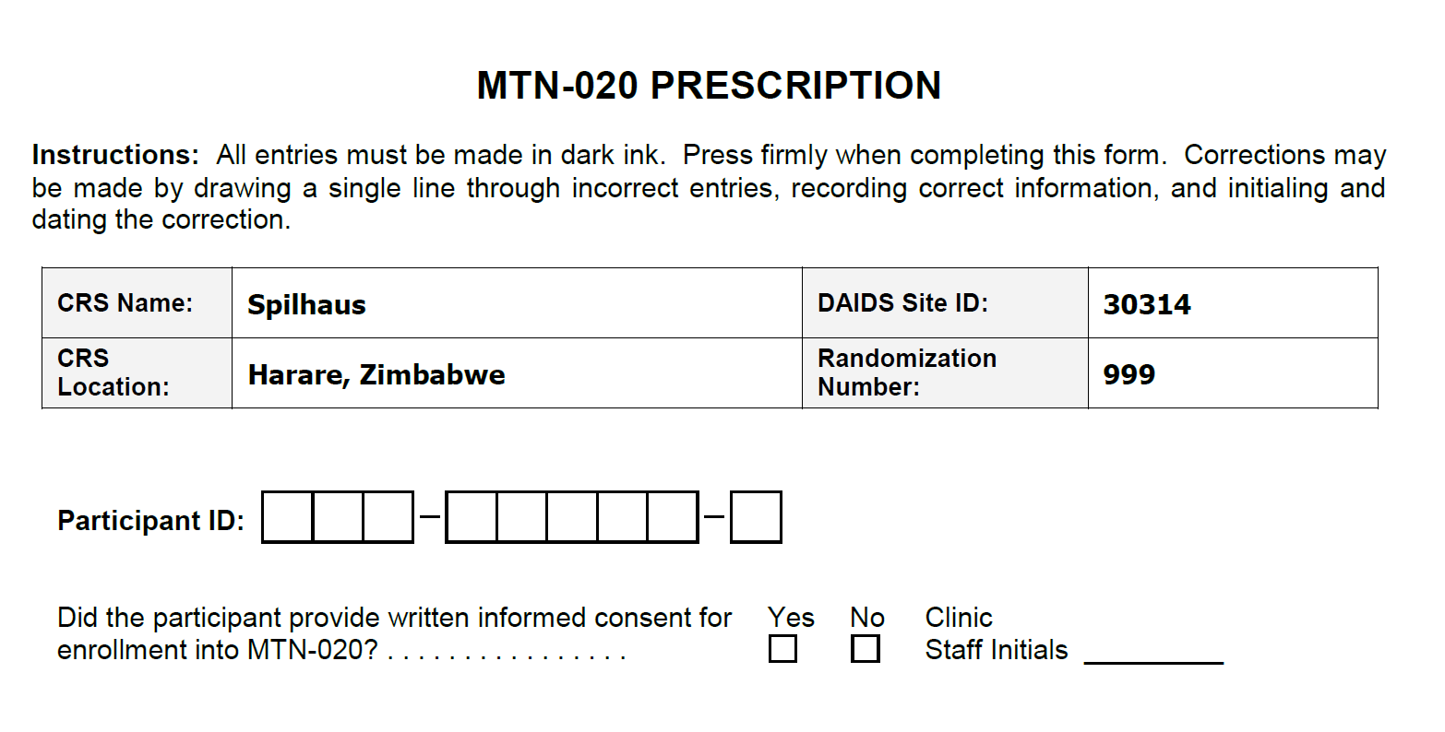
Notes:
Again, the preprinted randomization number should correspond with the randomization number on the randomization/prescription tracking record.

Slide 11
Prescription Completion
The middle section of the prescription must be completed by a study staff member designated in the site's delegation of duties as an authorized prescriber of study product.
This person also must be listed as an investigator (either the Investigator of Record or Sub-Investigator) on the current FDA Form 1572.

Slide 12
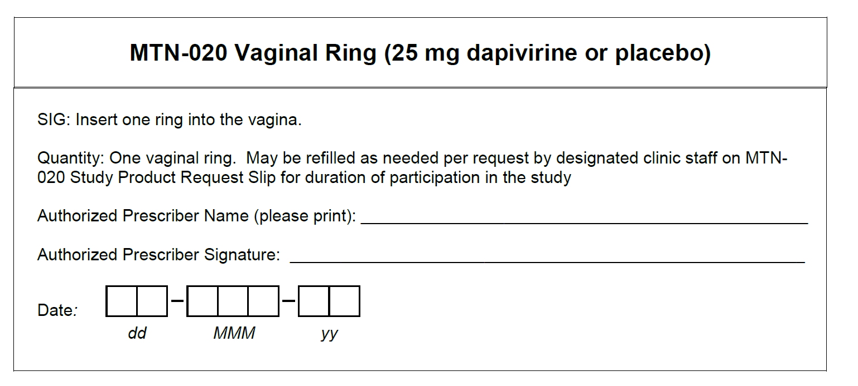
Notes:
This is the middle portion of the prescription and you can see it contains the quantity of one ring with refills as needed per MTN-020 Study Product Request Slip. The authorized prescriber printed name and signature is required here. An authorized prescriber is a clinician with authority to prescribe and is listed on the 1572.

Slide 13
Prescription Completion
The bottom section of the prescription requires clinic staff initials and the date once all of the above is completed.
This should be completed by the clinic staff who verifies that the participant signed the informed consent form and completed the top part of the prescription.

Slide 14
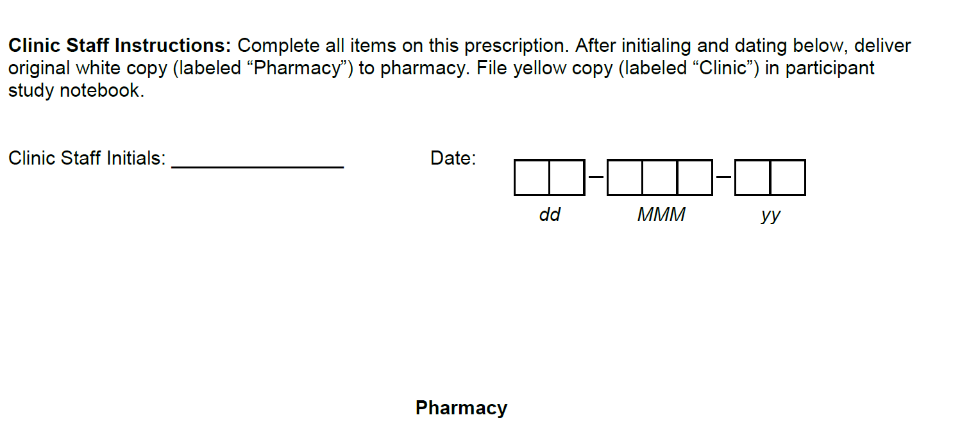
Notes:
The clinic staff should only initial and date after reviewing the prescription to verify it is completed with authorized signature.

Slide 15
Prescription Completion
Double-check the accuracy and completeness of all entries and then separate the two pages of the completed prescription
Retain the yellow (clinic) copy in the participant study notebook
Deliver the white (pharmacy) original prescription to the study pharmacy

Slide 16
Initial Product Dispensation
The pharmacist will review the prescription for completion and accuracy.
In the event that pharmacy staff identifies possible errors on the original (top, white) prescription, they will return the original prescription to clinic staff for clarification or correction.
If corrections are required, they must be made on both the white original prescription and the yellow copy.

Slide 17
Presecription Error Correction
Corrections should be made separately on the white (original) and the yellow (copy) sheet.
Signed and dated note on both copies explaining the correction, on the same date, by the same person.
Notes:
It is really important that any changes be made by the appropriate person (i.e. clinic staff or authorized prescriber) depending on the change and BOTH copies are done the same.

Slide 18
Initial Dispensation
The pharmacist will prepare the vaginal ring for dispensation.
The VR is picked-up by clinic staff
Allowance made to dispense to runner providing documentation outlined in Chain of Custody SOP.
MTN-020 Record of Receipts of Participant-Specific Study Product completed by pharmacy and clinic.
Notes:
Record of Receipts is the documentation of the Chain of Custody as product leaves the pharmacy. This documents who in the pharmacy gave the product to which clinic staff person.

Slide 19
MTN-020 RECORD RECEIPTS OF PARTICPANT-SPECIFIC STUDY PRODUCT
Notes:
The pharmacist will complete the left side of this form and the clinic staff will complete the right side. This serves as documentation for the ring going from the pharmacy to the clinic. This is part of the ring accountability.

Slide 20
VR Return Bag for Participant
Pharmacists will provide a white zip return bag with each ring dispensed.
This can be used to store the ring in the event that it is removed by ppt and will not be immediately re-inserted
  If temporary, suggest rinse and dry the ring if possible prior to placing in the bag
  If permanent removal, DO NOT rinse or wipe – just place in bag
Notes:
When the vaginal ring is dispensed the pharmacist will also provide a white zip bag with this preprinted label. The pharmacist will complete the date and PTID. Clinic staff must complete the emergency contact information. The purpose of the bag is to provide a place for the participant to place the ring in the event that it must be removed. If a participant’s ring is expelled in such a way that it is dirty but retrievable (i.e. falls in dirt) and they want to bring it back for disposal it goes in the bag. If a participant is given 2 rings they can rinse and dry the first ring and place in the bag for when they return to the clinic.

Slide 21
VR Return Bag
The pharmacist will complete the PTID and date on the bag.
The clinic staff will complete the clinic contact name and phone number.

Slide 22
MTN-020 PARTICIPANT RING RETURN BAG

Slide 23
Initial Dispensation – Accountability and Documentation
Clinic product accountability responsibilities will be covered during follow-up visit session
Enrollment CRF documents initial ring insertion for the study database
Notes:
An RCI-1 form is not completed at ENR

Slide 24
Emergency Unblinding
No circumstances under which it is expected unblinding will be necessary to protect participant safety
Product use may be held/discontinued if IoR is concerned about undue risk by continuing product
If IoR/designee feels that unblinding is necessary to protect ppt safety, notify the PSRT to consider and rule on request
Notes:
Reference: Protocol section 9.5 and 10.6

Slide 25
What are your questions?

